Slide 1

Used Cars Analysis
Team 11
Xi Zhao
Hanzhang Wang

Slide 2
Agenda
Project Introduction
Dataset Description
Project Methodology
Results and Analysis
References

Slide 3
Project Introduction
Background
The Covid-19 pandemic has led to an increase in used car sales as people avoid mass public transportation
People are more sensitive to vehicles cost
Motivations
A better understanding of the used cars market is crucial for the whole autos industry
Goals
To have a full picture of the used car market
To find out the correlation of car features and the price
To develop a healthy and powerful used car price prediction model

Slide 4
Dataset Description
This dataset contains every used vehicle entry within the United States between October 2020 to December 2020
The data has all relevant information on car sales including columns like price, condition, manufacturer, latitude/longitude, and 18 other categories
All the tabulated information of used vehicles for sale are from Craigslist
Dataset link: https://www.kaggle.com/austinreese/craigslist-carstrucks-data

Slide 5

Project Methodology
Clean data
Transform data
Visualize data
Descriptive Analysis
Correlation Analysis
Prediction By ML
Clean and rescale data
Apply model
Evaluate model
Identify correlation
Split data
Fit model
Evaluate model
Summarize results

Slide 6
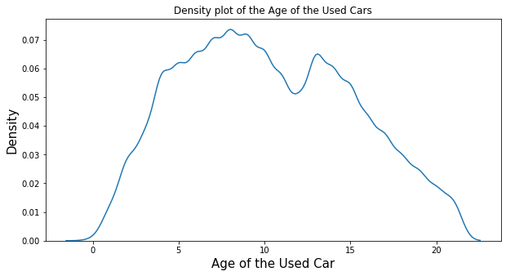
Descriptive Analysis - 1
People tend to sell their cars after using 5 to 10 years

Slide 7
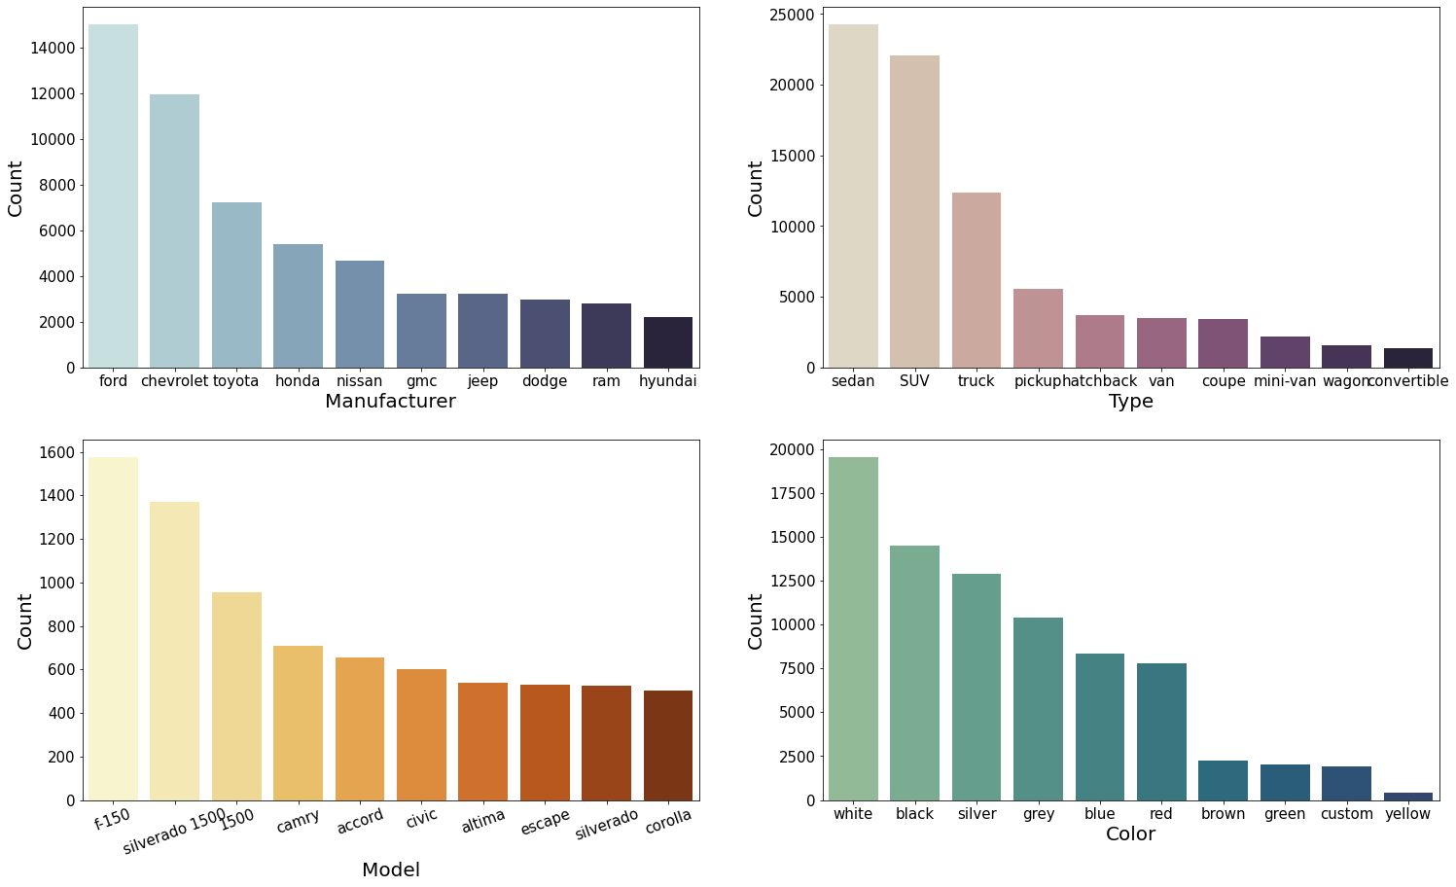
Descriptive Analysis - 2
Top 5 manufacturers are Ford, Chevrolet, Toyota, Honda, and Nissan
Top 5 car types are sedan, SUV, and truck
Top 5 car models are f-150, Silverado 1500, 1500
Top 6 car colors are white, black, silver, grey, blue, and red

Slide 8
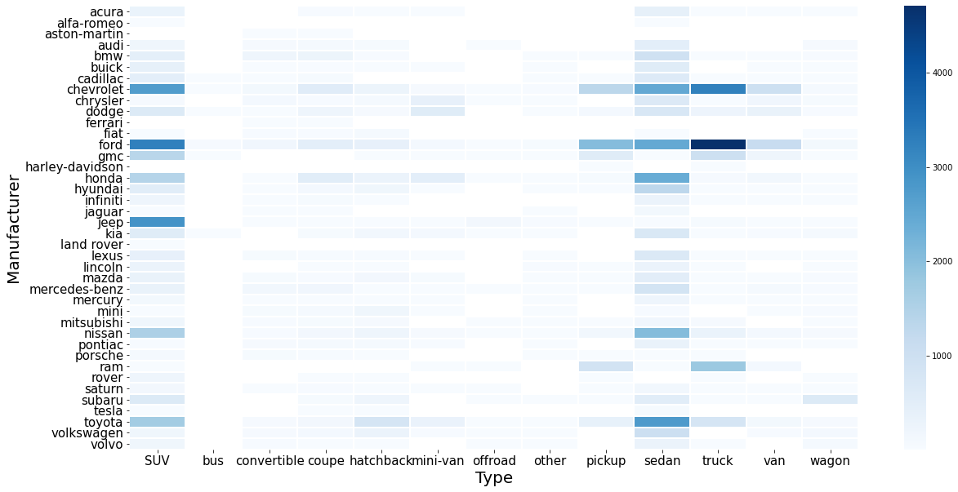
Descriptive Analysis - 3
Ford truck, Chevrolet truck, Ford SUV, Chevrolet SUV, Jeep SUV, and Toyota sedan are top posted used cars for sale

Slide 9
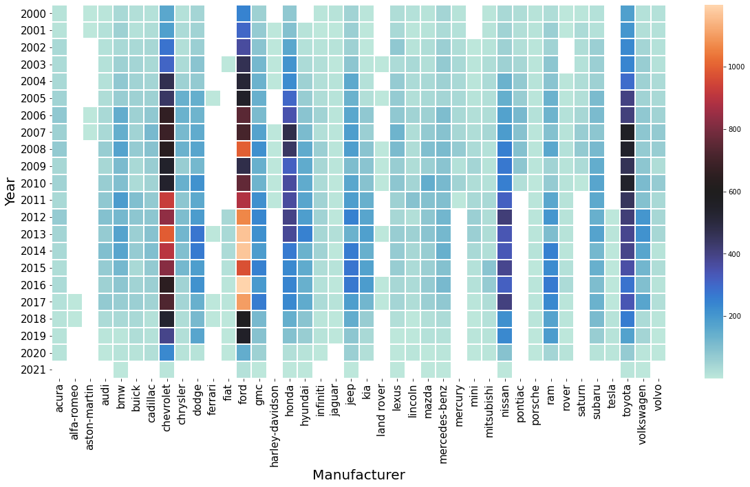
Descriptive Analysis - 4
Ford has the most posted used cars for sale between 2012 and 2018. And Chevrolet also has a lot of posts from 2011 to 2014

Slide 10
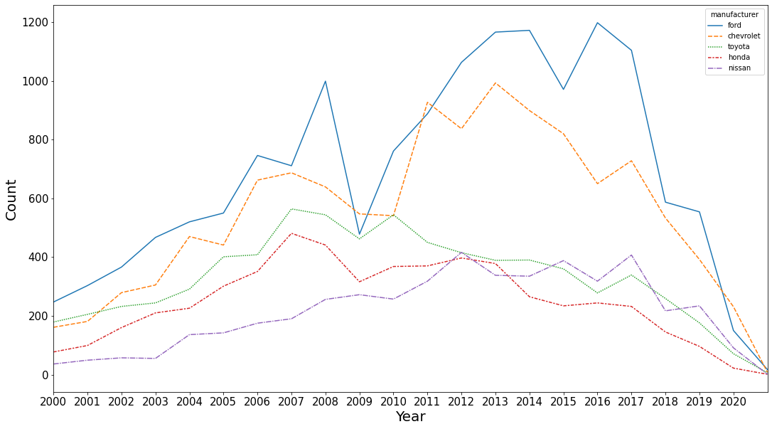
Descriptive Analysis - 5
From 2000 to 2020, Ford and Chevrolet both dominated the used car market

Slide 11
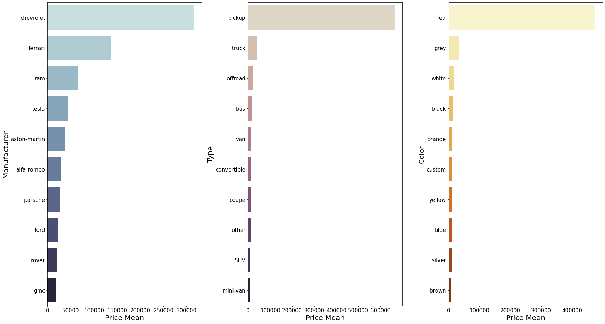
Descriptive Analysis - 6
Chevrolet, Pickup and Red cars are more expensive on average

Slide 12
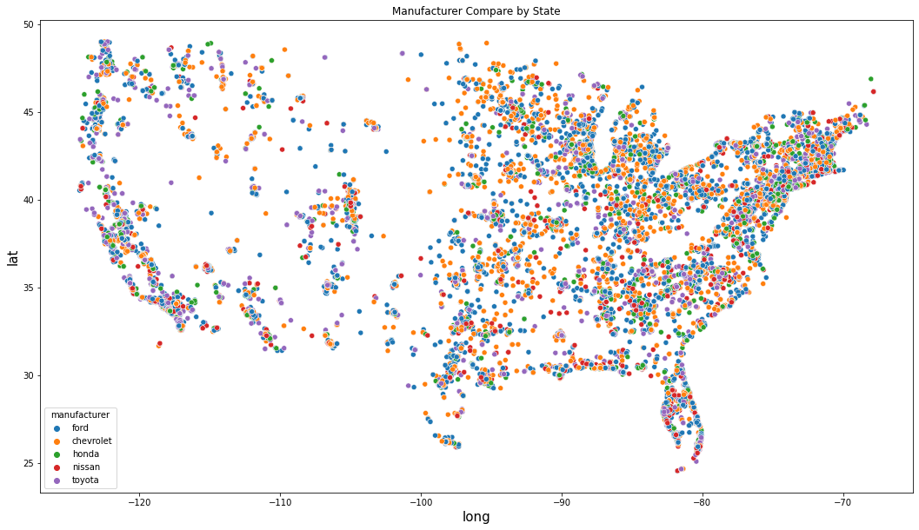
Descriptive Analysis - 7
For the top 5 manufacturers, used cars for sale posts were posted more from middle east and east coast

Slide 13
Correlation Analysis-1
Clean data for correlation analysis and further prediction
Drop useless columns
Check null values
# of null value in columns
region 0 price 0 year 1050 manufacturer 18220 model 4846 condition 192940 cylinders 171140 fuel 3237 odometer 55303 title_status 2577 transmission 2442 drive 134188 size 321348 type 112738 paint_color 140843 state 0 posting_date 28 dtype: int64
vehicles.drop(['id', 'url','region_url', 'VIN', 'image_url', 'lat', 'long', 'description'], axis=1, inplace=True)

Slide 14
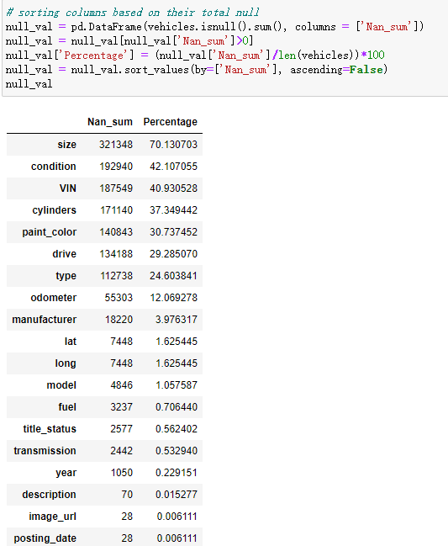
Correlation Analysis-2
Sort columns based on their total null
Keep columns which have less than 40% of missing values
Cleaned remain rows with missing values

Slide 15
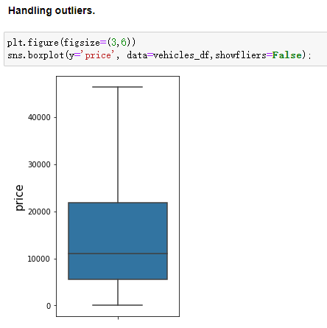
Correlation Analysis-3
Handle outliers

Slide 16
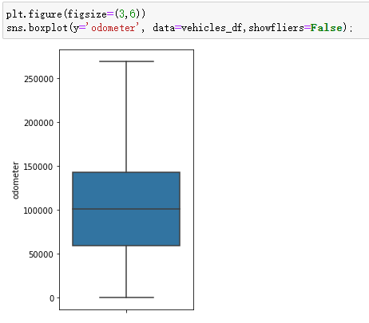
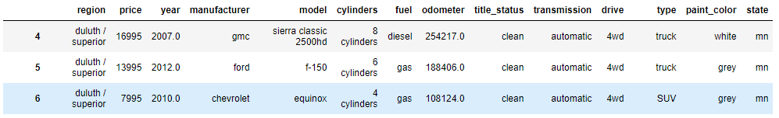
Correlation Analysis-4
Rescale column "Odometer"

Slide 17
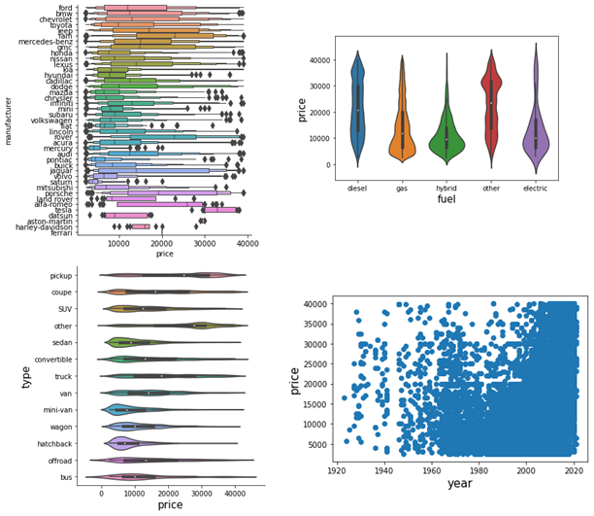
Correlation Analysis-5
Predictors with respect to target(price) for general understanding.

Slide 18
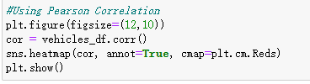
Correlation Analysis-6
Use Multiple Linear Regression to get the high relation features with price.
Filter Method
Backward Elimination Method

Slide 19
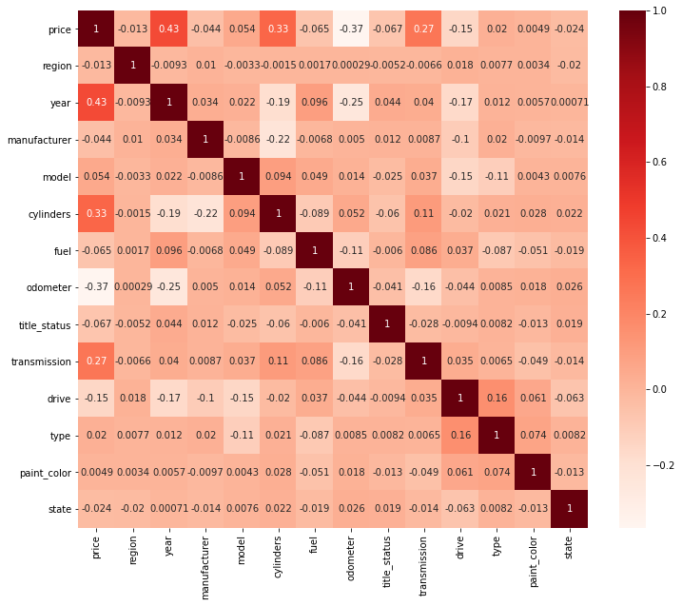
Correlation Analysis-7
Filter Method
Top 5 features related to price: year, cylinders, transmission, drive, and odometer

Slide 20
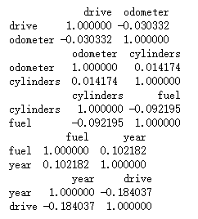
Correlation Analysis-8
Filter Method
Feature's independency check

Slide 21
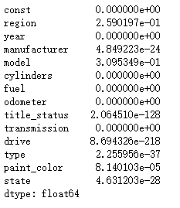
Correlation Analysis-9
Backward Elimination
Feed all the possible features to the model at first.
Iteratively remove the worst performing features one by one till the overall performance of the model comes in acceptable range (0.05).

Slide 22
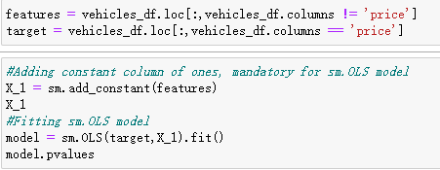
Correlation Analysis-10
Backward Elimination
Kept eliminating features and fit model until maximum p values is below 0.05
Top 5 features related to price:
year
cylinders
transmission
drive
odometer

Slide 23
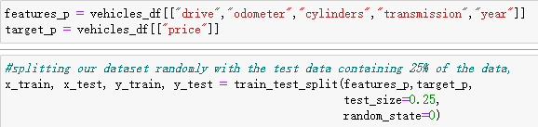
Predication by Machine Learning-1
Use Multiple Linear Regression Model for both method
The one with higher accuracy stands for MLR
First, we used Filter Method of MLR model.

Slide 24
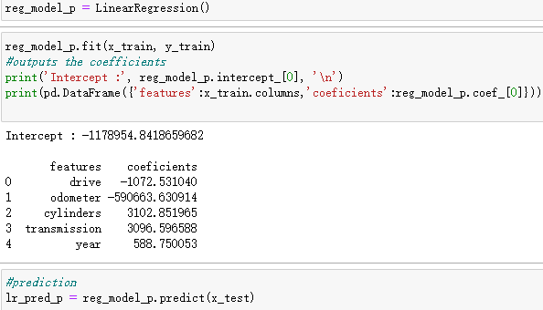
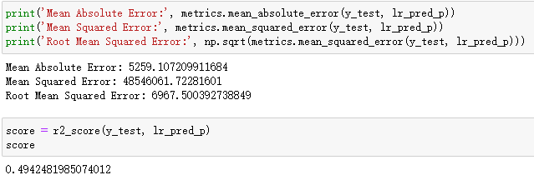
Predication by Machine Learning-2
Fit the model (Filter Method)

Slide 25
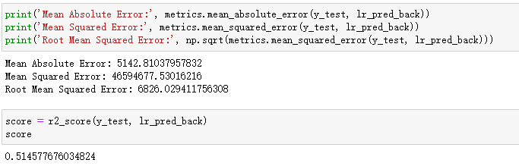
Predication by Machine Learning-3
Fit the model (Backward Elimination)
Backward Elimination method has slightly higher R² score.
We used results from Backward Elimination method to stand for the MLR model results.
Top 5 features which have high relationship with price are year, manufacturer, cylinders, fuel, and odometer.

Slide 26
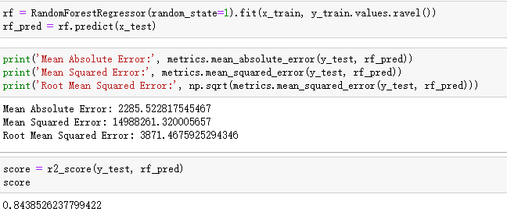
Predication by Machine Learning-4
Random Forest Model
We can see that the R² score of Random Forest is 0.84, while MLR model’s is 0.51. Therefore, Random Forest Model is the optimal model for the used car dataset.

Slide 27
References
Rosenbaum, Eric. (2020,October 15). The used car boom is one of the hottest, and trickiest, coronavirus markets for consumers. https://www.cnbc.com/2020/10/15/used-car-boom-is-one-of-hottest-coronavirus-markets-for-consumers.html
JeongBin_Park. (2021, March). Craigslist_Car Data Analysis. https://www.kaggle.com/jeongbinpark/craigslist-car-data-analysis/data#1.Data-setting
Deep Shah. (2020, November). Used Cars EDA. https://www.kaggle.com/deepshah16/used-cars-eda
Nurlaida. (2021, April). Exploratory Data Analysis. https://www.kaggle.com/ideayahya/exploratory-data-analysis-framework-created
Vitalii Mokin (2020, April). Used Cars Price Prediction by 15 models. https://www.kaggle.com/vbmokin/used-cars-price-prediction-by-15-models
Aneri Savani (2020, October). EDA and price prediction of used vehicles. https://www.kaggle.com/anerisavani/eda-and-price-prediction-of-used-vehicles

Slide 28
Thank You

